Slide 1
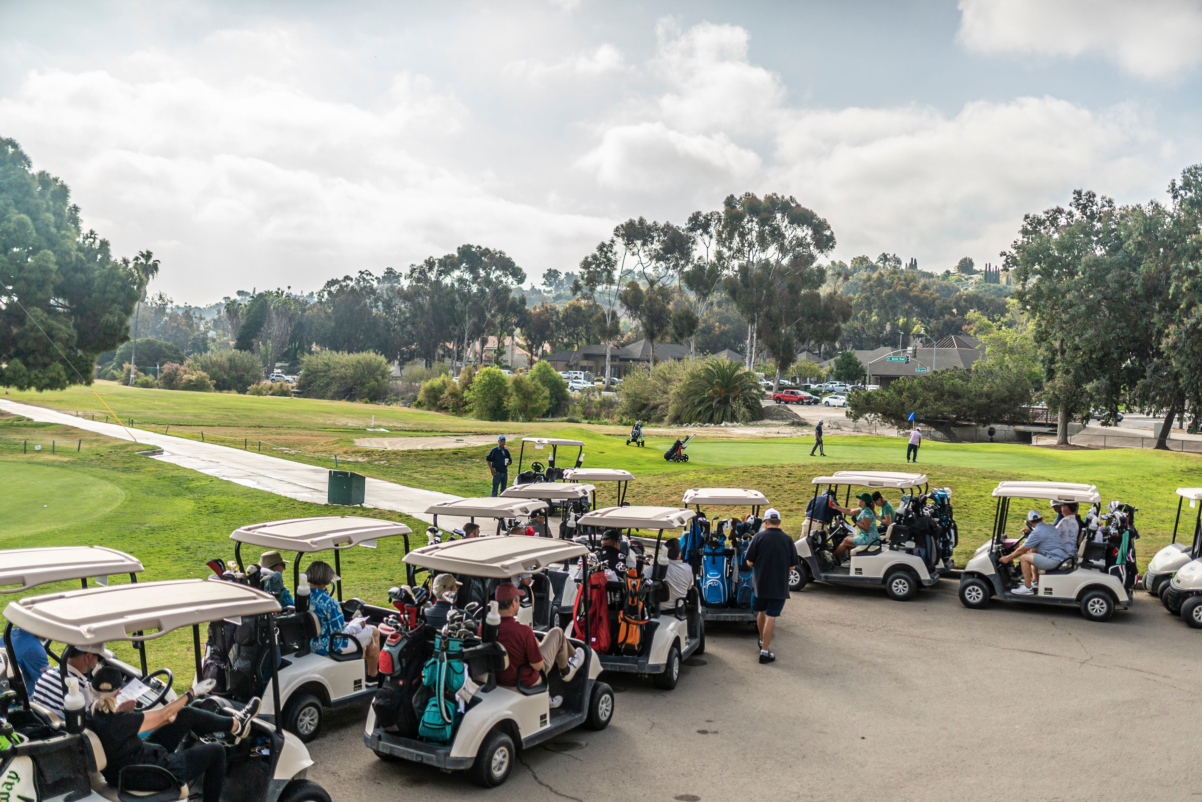
2023
Golf Tournament Packages
4475 Bonita Rd Bonita,CA 91902
Contact: Armando Najera
619-479-4141 x221

Slide 2
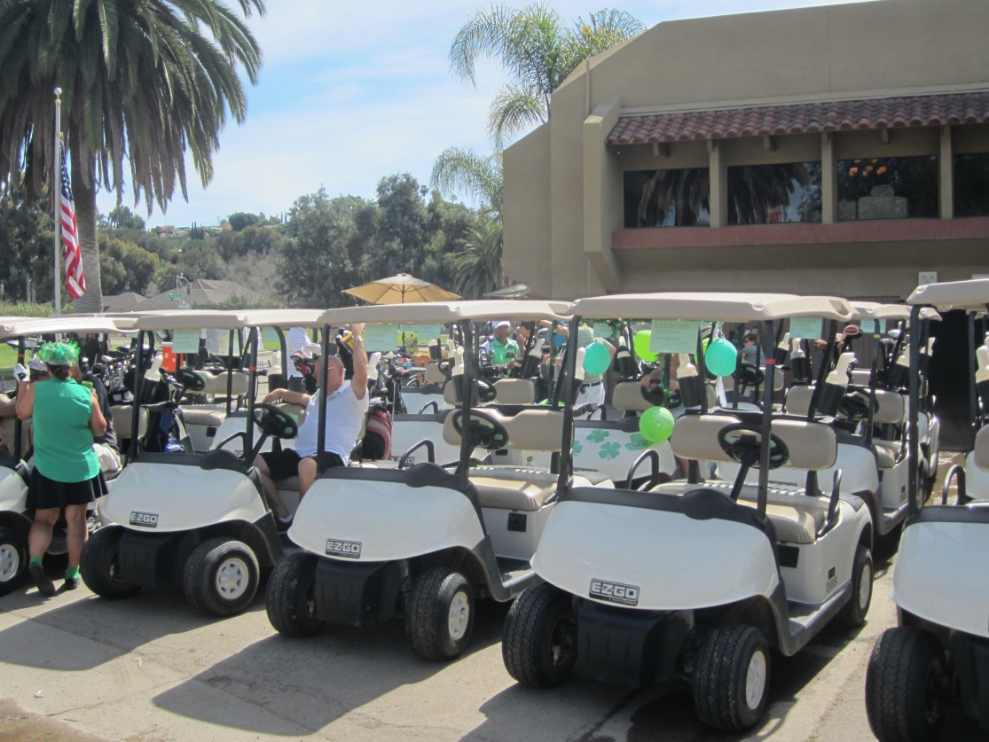
18 Hole, Par 73, Designed by Billy Casper, Chula Vista Golf Course is one of the best courses to play and the best course to host your tournament in San Diego County. With a combined 20 years of golf tournament experience General Manger Armando Najera and his staff are ready to host your group. With 3 unique banquet room facilities complemented by unmatched service and top-notch amenities—everything you need for an exceptional golf tournament experience.

Slide 3
Golf Tournament Amenities
All tournament packages include:
Green Fee & Cart Fee
Range Balls
Scorecards
Cart signs
Special Contest and Proximity Markers
Twosome Gift Certificates
(1 for every 32 players)
Registration Tables and Set-Up
Tournament Coordination-
-Launch and Transition
Tournament Scoring

Slide 4
Buffet Options
EARLY TEE TIME
FRESH ASSORTED MUFFINS
FRESH ASSORTED DANISHES
ASSORTED YOGURT TO GO
FRESH FRUIT CUPS TO GO
GRANOLA BARS
CVGC DELI BUFFET
ASSORTED DELI MEATS
POTATO CHIPS
FRESH FRUIT
FRESH BAKED COOKIES
BOTTLED BEVERAGE
SLIDER BAR
CHEESEBURGER SLIDER
HOT DOG SLIDER
POTATO CHIPS
COLESLAW
FRESH BAKED COOKIES
BENTO
CHICKEN TERIYAKI
STEAMED VEG MEDLEY
MACARONI SALAD
STEAMED RICE
FRESH BAKED COOKIES
GOLF FIESTA
CHICKEN FAJITAS
CHEESE ENCHILADAS
RICE & REFRIED BEANS
CHURROS
SHORT PAR 4
ROASTED CHICKEN LEG QUARTERS
BAKED BEANS
COLESLAW
POTATO SALAD
FRESH BAKED COOKIES
TEXAS WEDGE
BBQ TRI TIP
BAKED BEANS
COLESLAW
POTATO SALAD
FRESH BAKED COOKIES
ISLAND GREEN
LEMON PEPPER TILAPIA
HOUSE SALAD
WILD RICE PILAF
ROASTED ASPARAGUS
ASSORTED ROLLS W/ BUTTER
FRESH BAKED COOKIES

Slide 5
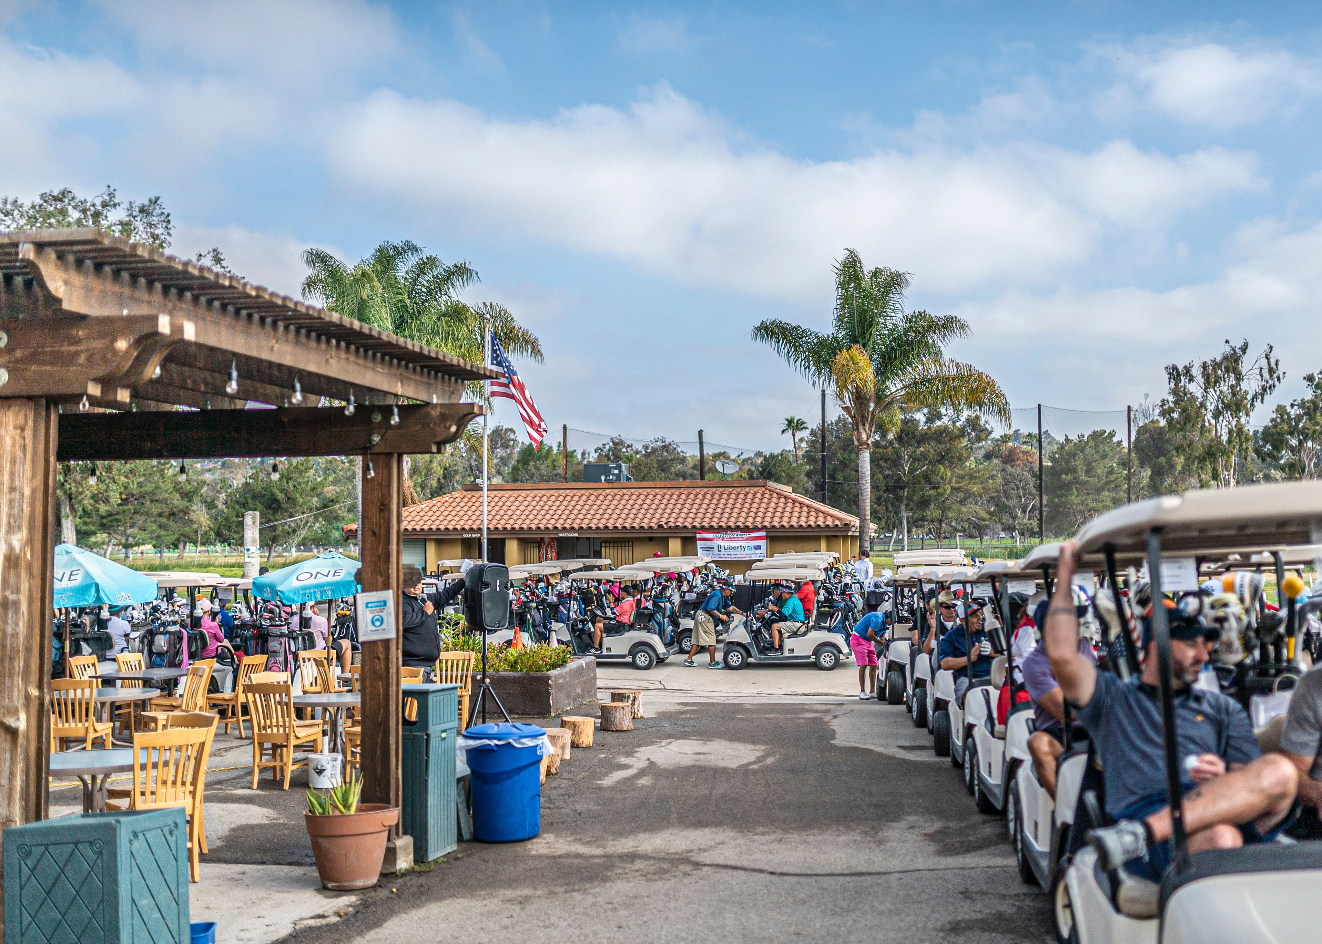
Tournament Add-On’s
Lunch Tickets
Good for your choice of a hamburger/cheeseburger,
deli sandwich or hot dog and a bag of chips and a 22oz
fountain soda.
Boxed Lunches
Includes turkey hoagie, bag of chips, fresh fruit, fresh
baked cookie and a
drink ticket
Drink Tickets
Good for any bottled soda, water, Gatorade, domestic or import canned beer, well cocktail or
4 ounce glass of wine
or
Good for any ticket option any premium cocktail or
16oz draft beer
*All food and beverage subject to tax and service charge.

Slide 6
Important Deadlines
7 Days After Contract is Received
Signed Confirmation Agreement
30-45 Days Prior to Your Event
Meet with Armando to finalize details and choose food and beverage selections
Sign Banquet Event Order, Floors Plans, and Invoice
Submit all Contest: Request Closest to Pin, Long Drive etc.…
7 Days Prior to Your Event
Final Head Count
Final Meal Count
3 Days Prior to Your Event
Pairings List/Groups list
Rental Club Needs
Day of Your Event
Arrive 2 Hours Early
Relax and Breath… We here at the Chula Vista Golf Course are here to ensure your event goes off flawlessly.

